Slide 1
App in a Day
Microsoft Power platform
Power Apps
Power Automate
Power BI
Common Data Service

Slide 2



Microsoft Power Platform
The low-code platform that spans Office 365, Azure, Dynamics 365, and standalone applications
Power BI
Business analytics
Power Apps
Application development
Power Automate
Process automation
Power Virtual Agents
Intelligent virtual agents
Data connectors
Common Data Service
AI Builder
Notes:
The Microsoft Power Platform – Empowering millions of people to achieve more
Our vision for the Power Platform started from the recognition that data is increasingly flowing from everything, and a belief that organizations that harness their data – to gain insights then used to drive intelligent business processes – will outperform those that don’t.
We also recognize there aren’t enough programmers, data scientists and tech professionals to go around. So our goal was to build a platform targeting these technology experts and the millions of other frontline workers who see opportunities every day to create something better than the status quo, but who’ve never been empowered to do anything about it.
Our guiding vision was a framework we called the “Triple-A Loop” – a closed-loop system allowing users to gain insights from data (Analyze) used to drive intelligent business processes via apps they build (Act) and processes they automate (Automate).
The Microsoft Power Platform implements this vision via three cloud-based services: Power BI, PowerApps and Flow.
PowerApps is our low code application development platform – allowing anyone to build web and mobile applications without writing code. The natural connection between Power BI and PowerApps makes it effortless to put insights in the hands of maintenance workers, teachers, miners and others on the frontline, in tailored and often task-specific applications that supercharge their productivity and make their work perhaps a little less tedious.
Like Power BI, PowerApps connects to hundreds of business systems and databases, making it easy to connect workers with the existing processes and data that makes the business tick. And all the data captured in PowerApps can make its way right back to those very systems for further analysis in Power BI creating a closed-loop process for continuous improvement.
Additionally, PowerApps comes with a built-in, fully-managed, enterprise-grade datastore called the Common Data Service (CDS) for those applications that generate data not destined for a legacy system – and Power BI and Flow have deep connections to CDS making it that much easier to get even more value from data stored there.
Extending the Power Platform via connectors to other Microsoft offerings allow our clients to leverage those investments and create productivity faster.
With Office 365, we offer a complete intelligent solution that empowers your employees to creative, collaborate and work together with Office 365, Skype, Teams
With Dynamics 365, our intelligent business applications, we offer a complete set of solutions across Marketing, Sales, Commerce, Service, Finance, Operations and Talent.
With Microsoft Azure we are delivering the most productive, hybrid, intelligent, and trusted cloud to run your business.
Azure is offered in 54 regions, more than any cloud provider;
Offers 70+ compliance industries, the largest portfolio in the industry;
95% of Fortune 500 companies run on Azure

Slide 3
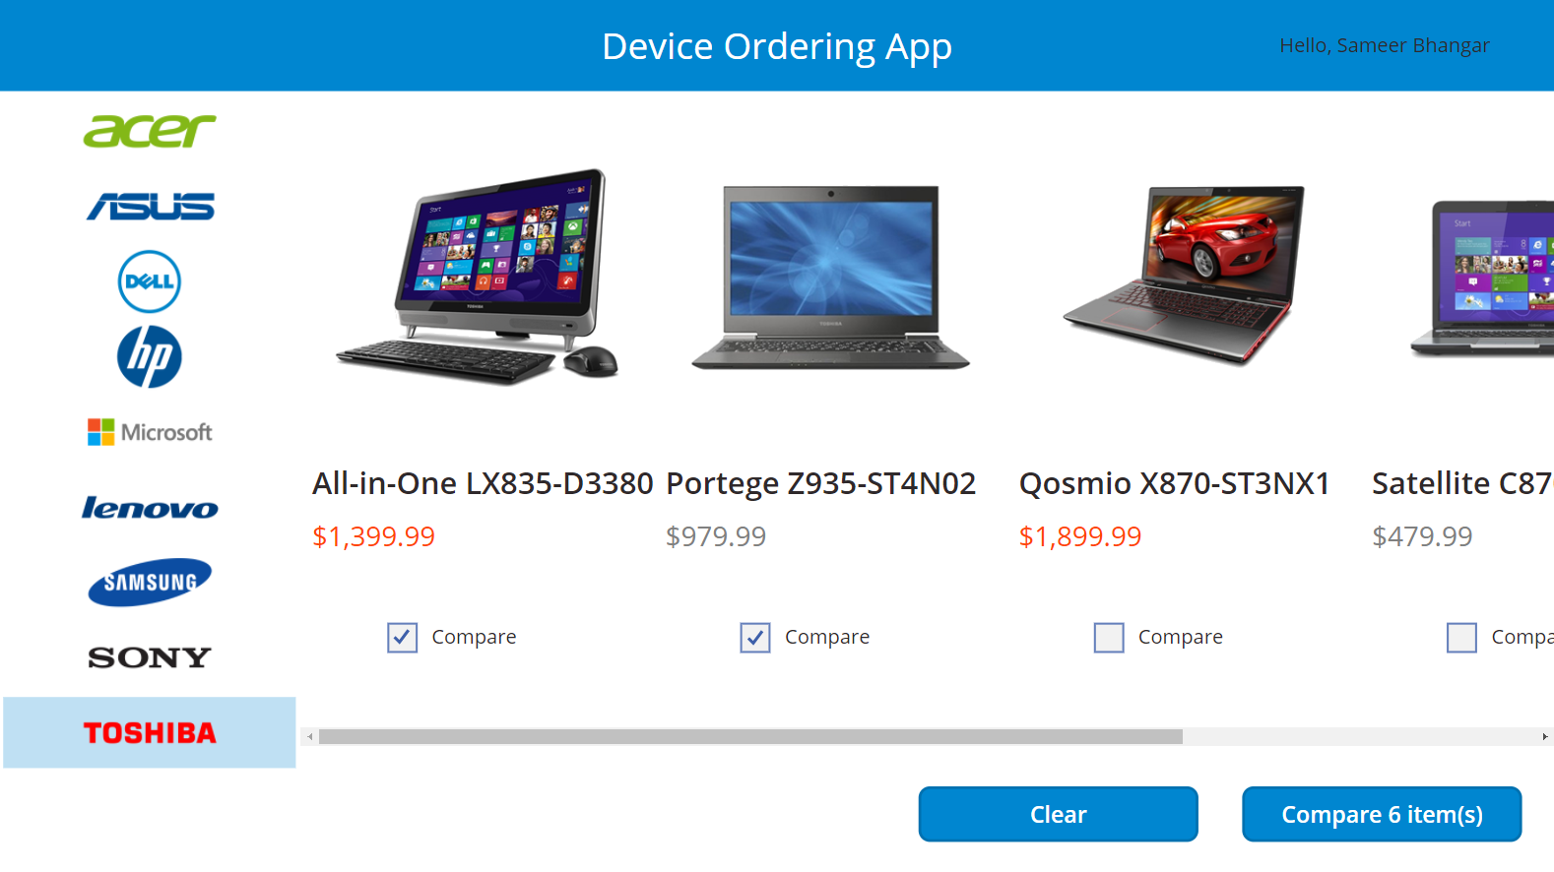
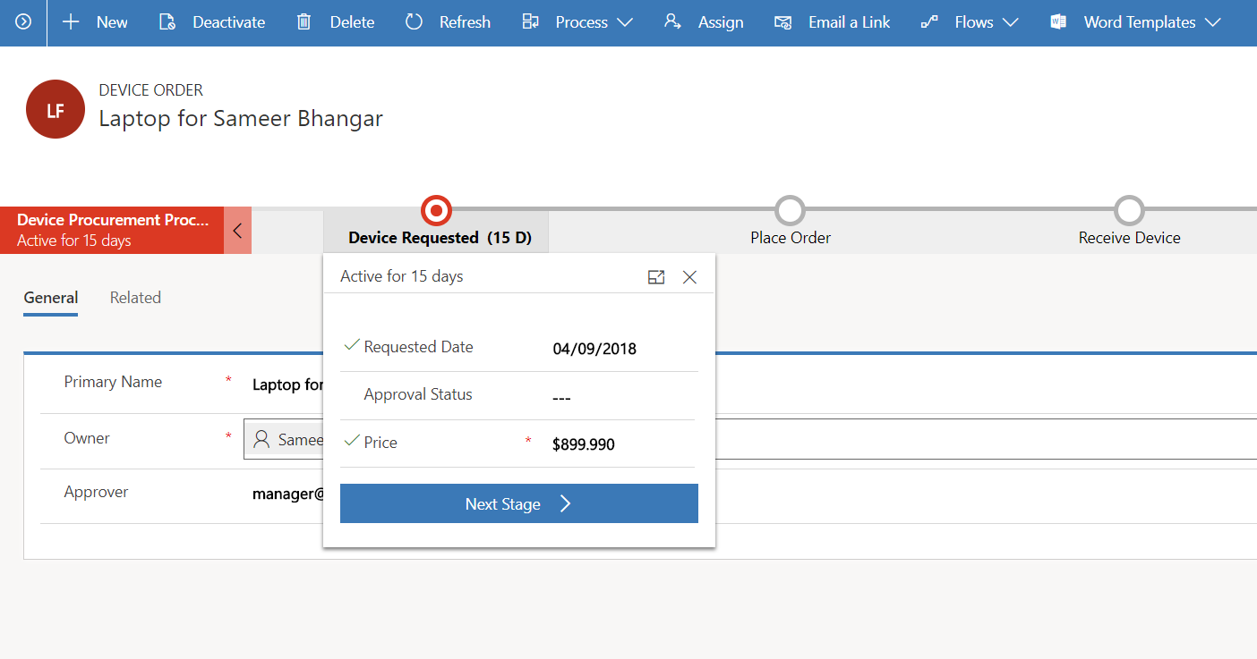
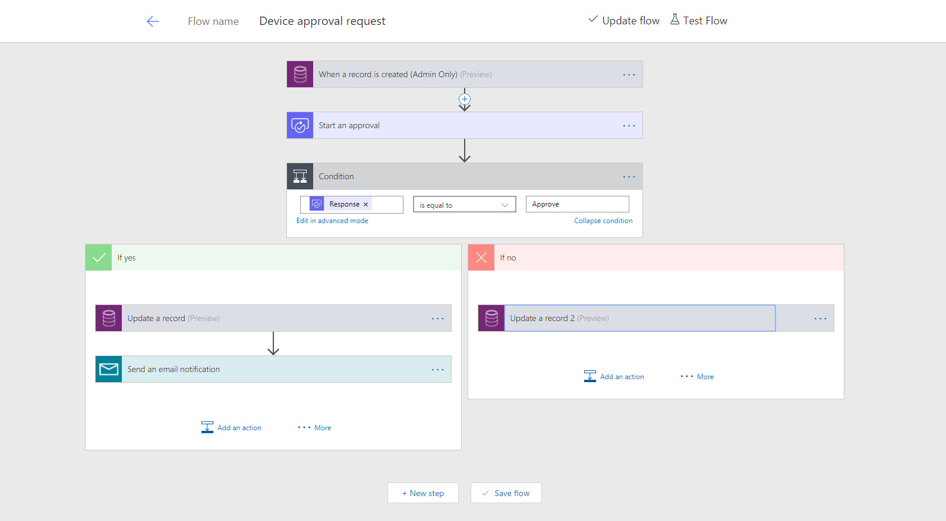
Business scenario for hands-on lab
Imagine an organization where every three years employees go through a hardware refresh cycle
They would like to streamline the device order and approval process, and view aggregate reports
The employee facing app to order a device needs to run in a web browser and on mobile devices

Slide 4
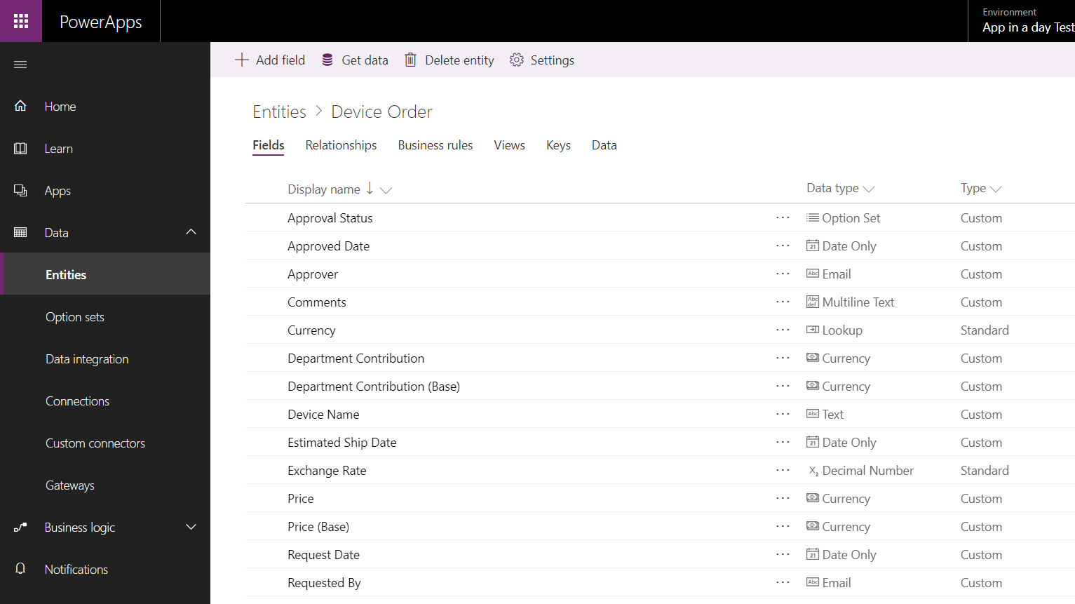
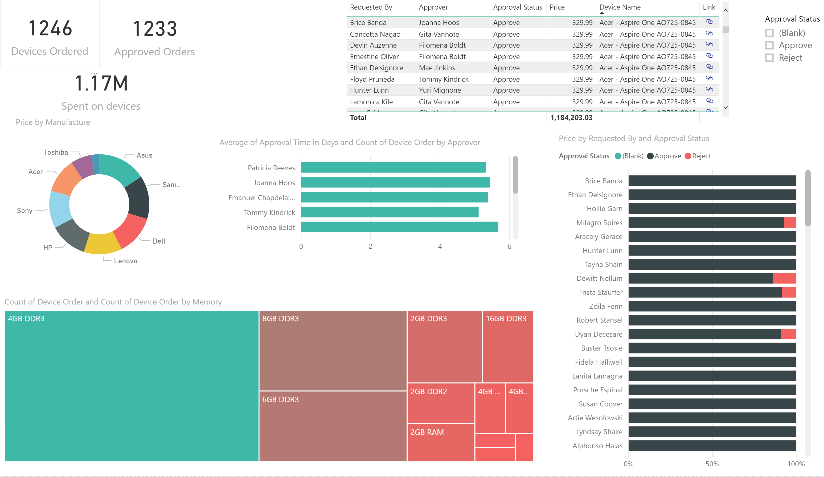
Lab objectives
Build a Power Apps Canvas App for employee facing device ordering experience
Use Common Data Service to store the device orders in the cloud
Build a Power Apps Model-driven App to complete the procurement process
Use Power Automate to build an approval workflow for device approval
Use Power BI to visualize device order data

Slide 5
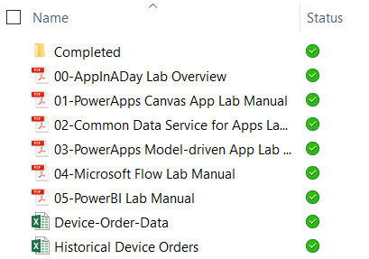
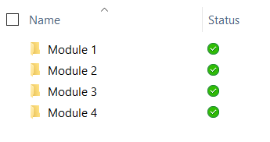
Lab content
Lab docs:
Package: http://aka.ms/appinaday
Unzip the package on your local machine
Follow instructions: “00-AppinaDay Lab Overview.pdf”
Contains 5 modules with a lab doc for each:
01-Power Apps Canvas App
02-Common Data Service for Apps
03-Power Apps Model-driven App
04- Power Automate
05-Power BI
Completed Modules:
The \Completed folder contains solution packages that you can import
e.g. To work on Module 5 without completing previous modules -> see \Completed\Module4
Completed modules:

Slide 6
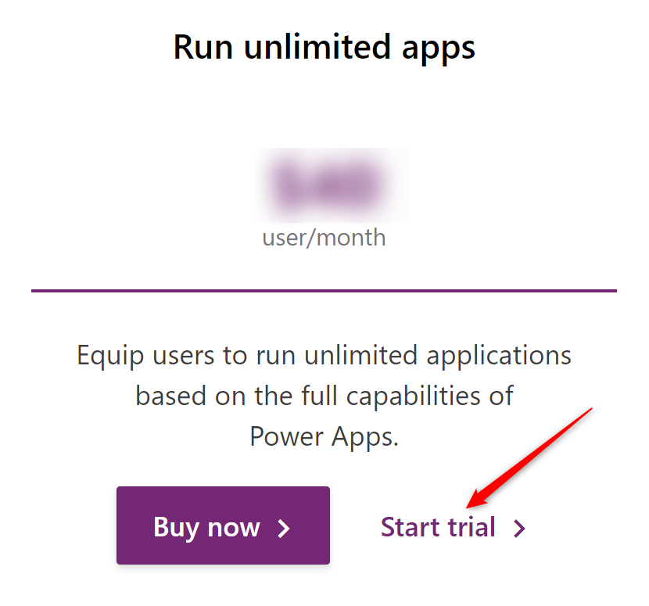
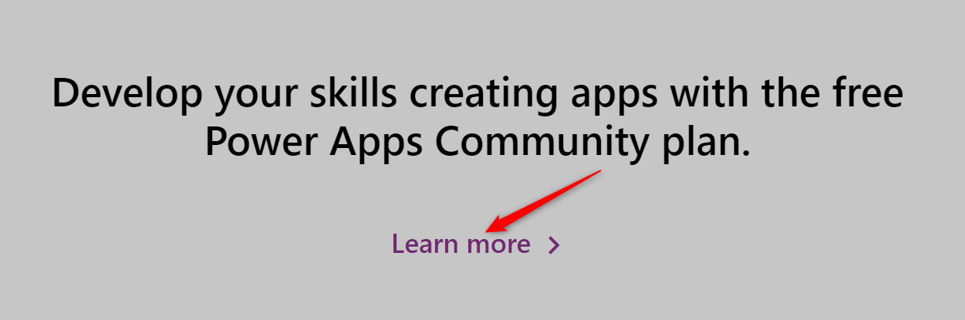
Pre-requisites
Valid Power Apps license:
Common Data Service usage requires a Power Apps premium license
Visit https://powerapps.microsoft.com/pricing/ and click Start Trial or sign up for a free Community plan.
If you are unable to acquire a trial license:
Ask the instructor for a trial user account that you may use for this session OR
Create your own Office 365 trial tenant – http://aka.ms/Office365E5Trial
Power Apps authoring environment:
Launch https://make.powerapps.com using any modern browser
Power Apps mobile apps (Optional):
PowerApps – iOS : https://aka.ms/PowerAppsiOS
PowerApps – Android : https://aka.ms/PowerAppsAndroid

Slide 7
Provision environment and Common Data Service
This lab requires a new Power Apps environment and CDS database that was provisioned for this class.
Go to the Power Apps Admin center – http://admin.powerapps.com
Select +New environment, fill out the form using a Trial Environment, and select Create Environment
Select the Create database option
Fill out the form, check the box to include sample apps and data and select Create my database
Your new environment will be added to the list of environments
IMPORTANT: The database has not yet been provisioned
Select the environment you just created
Wait for the “Provisioning database…” message to go away
You may need to refresh the screen every couple of minutes
Once the provisioning is complete, then proceed to create apps in the environment

Slide 8
Module 1: Power Apps Canvas App
Hands-on-lab

Slide 9
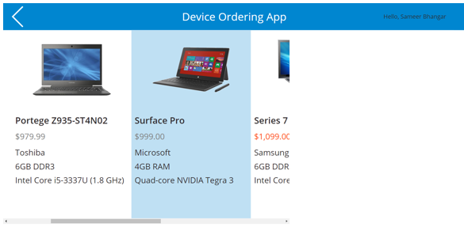
Learning objectives
Sign-in and create a new Canvas App
Connect to data sources
Filter data
Work with multiple screens and navigation
Customize the user experience – galleries and controls

Slide 10
Module 2: Common Data Service
Hands-on-lab

Slide 11
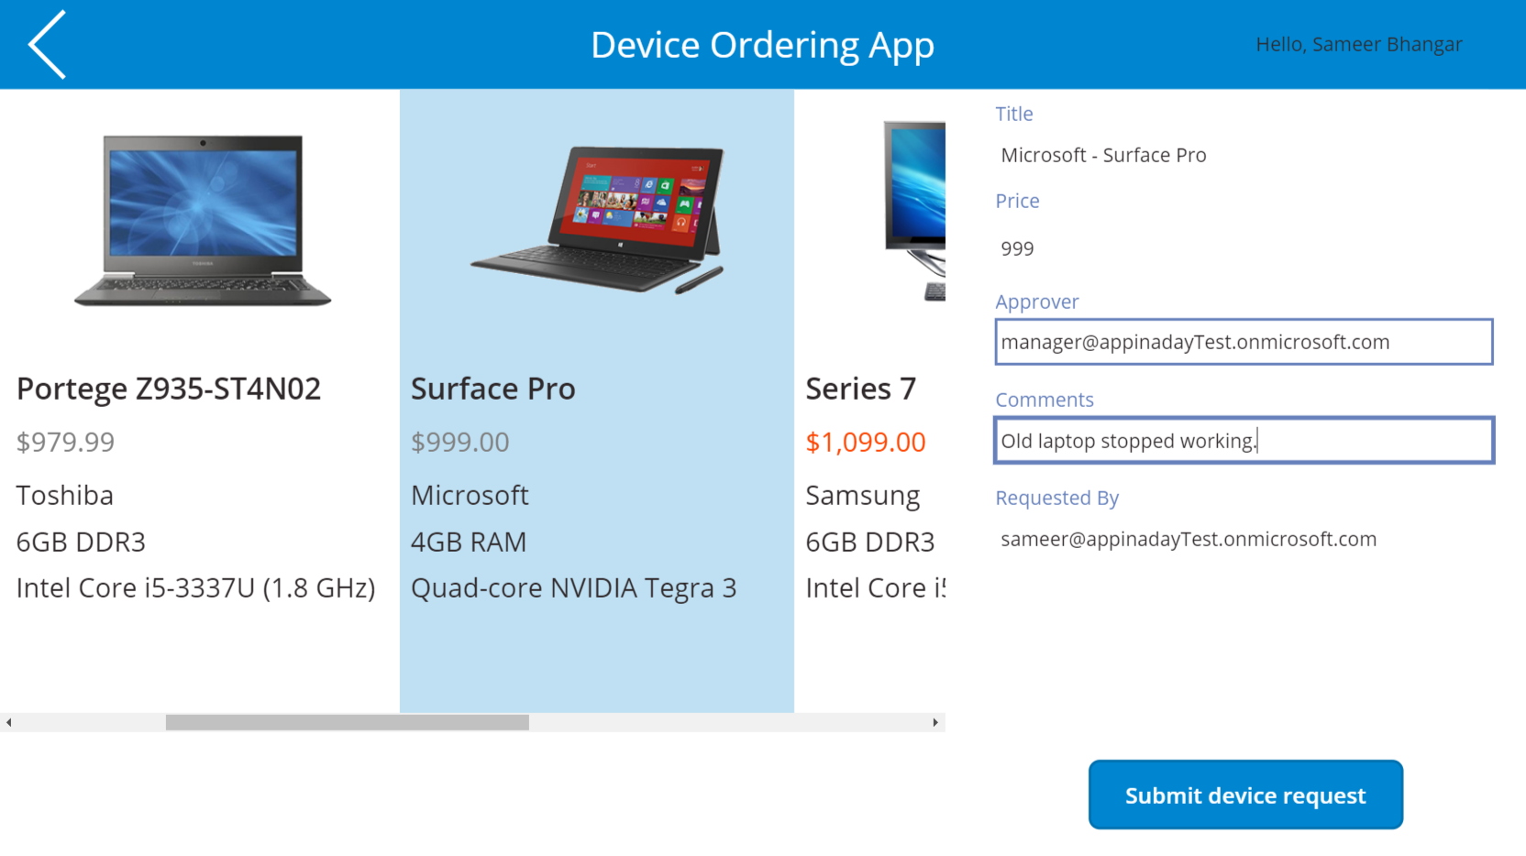
Learning objectives
Provision a Common Data Service instance
Get familiar with standard entities
Create a custom entity
Customize entity fields and option sets
Create calculated fields
Use the Canvas app form control to save data to CDS
Use the Office365 connector to get user’s manager info
Configure Canvas app settings
Save and share a Canvas app
Run a Canvas app on a mobile device

Slide 12
Module 3: Power Apps Model-driven App
Hands-on-lab

Slide 13
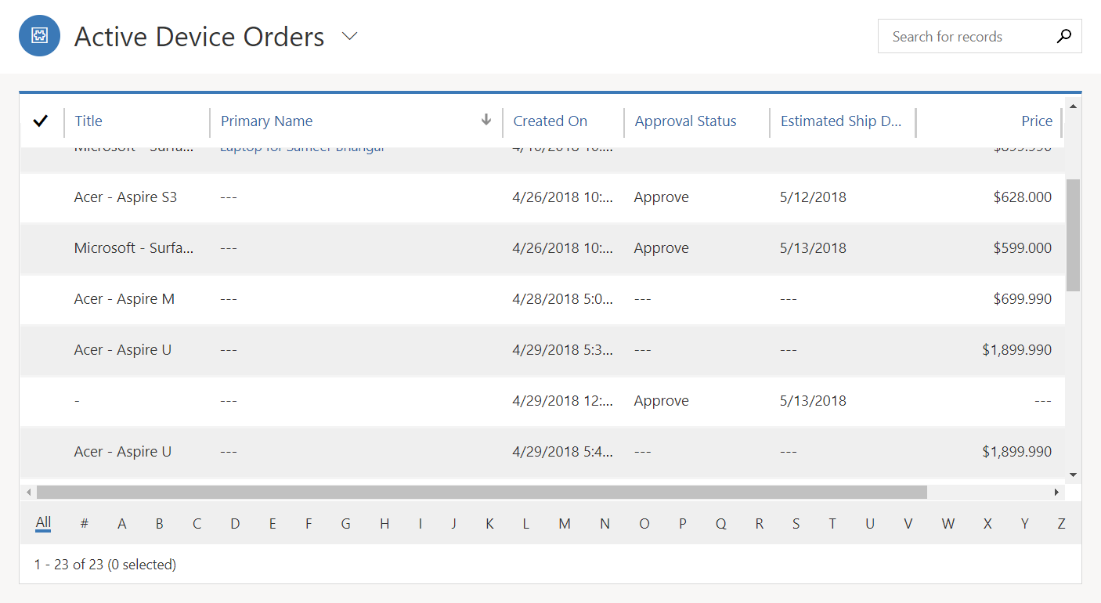
Learning objectives
Create a standalone Model-driven app
Customize forms for the Model-driven app
Create a Business Process Flow

Slide 14
Module 4: Power Automate
Hands-on-lab

Slide 15
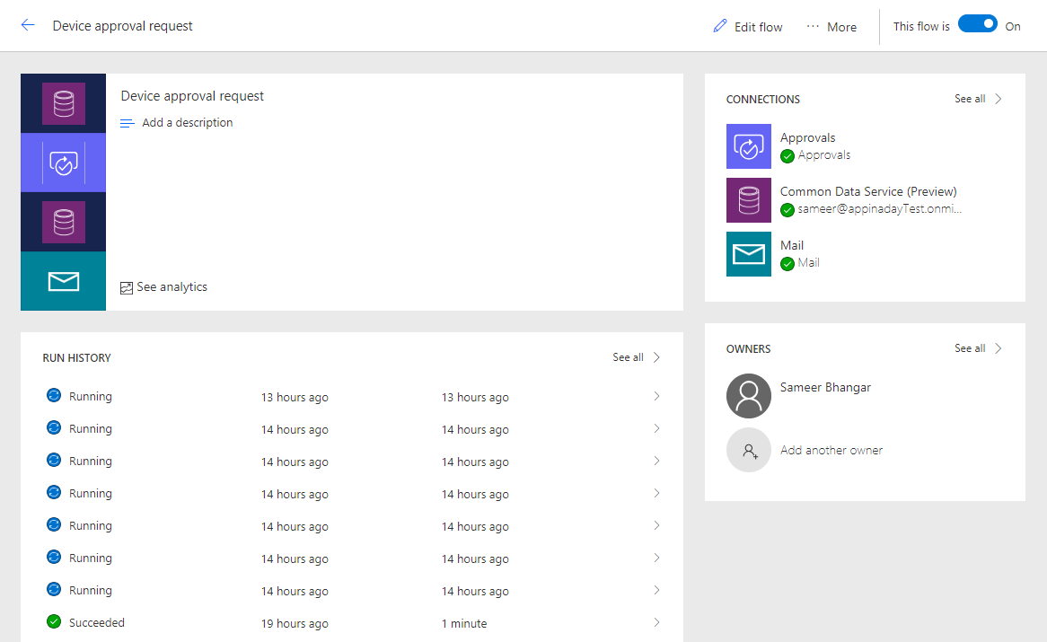
Learning objectives
Trigger a flow when a new record is created in CDS
Send an approval request
Conditional branching based on the approval response
Send email notifications
Update the CDS record with the approval status and the approver’s comments
Use the approval center on web and mobile
Check the status of flow runs

Slide 16
Module 5: Power BI
Hands-on-lab

Slide 17
Learning objectives
Connect Power BI to the Common Data Service
Transform CDS data for use in visualizations
Create visualizations on the CDS data
Combine CDS data with other data sources

Slide 18
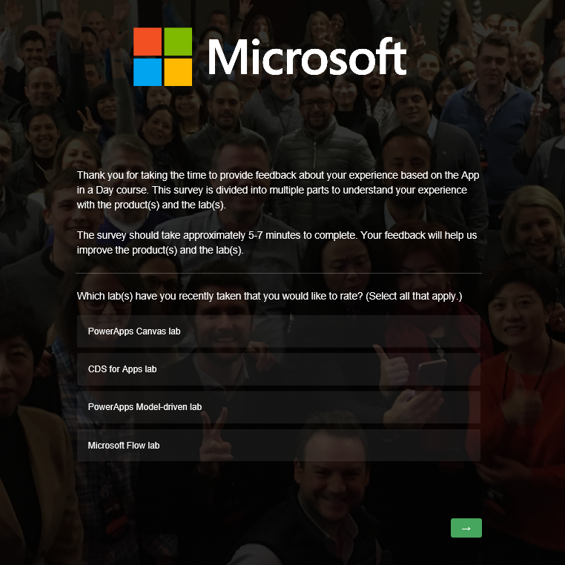
Lab survey
http://aka.ms/appinadayLabSurvey

Slide 19
Learning resources
aka.ms/PowerPlatformResources
aka.ms/Flow-resources
Customer stories & videos
aka.ms/PowerAppsStories
aka.ms/PowerPlatformVideos
aka.ms/PowerPlatformResources → see Customer Stories section

